Slide 1


INVENTORY MANAGEMENT SYSTEM
Presented by: -
Group 22
Aditya Jain [0905IT191004] Aman Gupta [0905IT191009] Sakshi Bhatnagar [0905IT191051] Vishal Jain [0905IT191064] Vivek Sharma [0905IT191067]

Slide 2
CONTENTS
INTRODUCTION
ADVANTAGE OF IMS SYSTEM
WHY PEOPLE WILL BUY/USE IMS SYSTEM
FLOW DIAGRAM
TABLE USED
FUTURE SCOPE

Slide 3

INTRODUCTION TO IMS SYSTEM
An inventory management system project that allows user to manage and maintain his/her inventory with ease. The inventory management system has been developed to allow users to add an inventory, delete an inventory, enter inventory quantity and other details, update inventory status and more. The inventory management system has its own intelligently managed support system that allows user to view and manage various inventories added in the system.

Slide 4
ADVANTAGE OF IMS SYSTEM
Better Inventory Accuracy
Reduced Risk of Overselling Cost Savings Avoiding Stock outs and Excess Stock Greater Insights
Better Terms With Vendors and Supplier More Productivity
Increased profits
A more organized warehouse
Better customer experience

Slide 5
WHY PEOPLE WILL BUY/USE IMS SYSTEM
Keeps track of your inventory and offers a centralized view of stock.
Controls your costs by making stock reports for analysis of your inventory.
Improves your delivery by managing stock-outs and meeting customer expectations.
Manages planning and forecasting by analyzing data trends.
Reduces the time for managing inventory by keeping records in place.

Slide 6
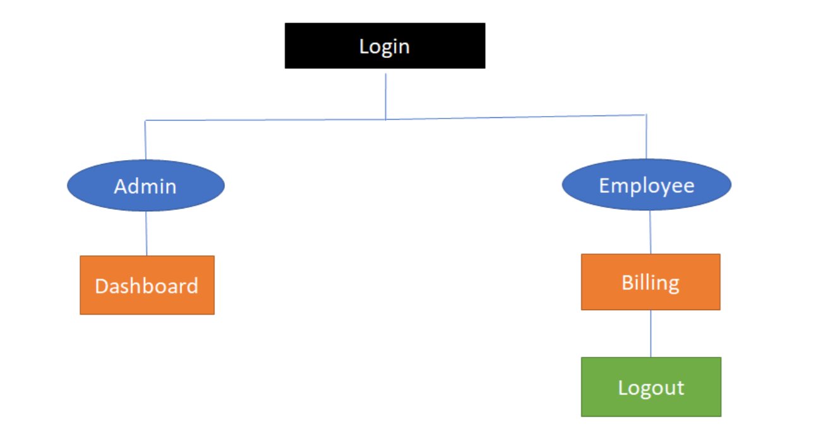
FLOW DIAGRAM OF IMS SYSTEM

Slide 7
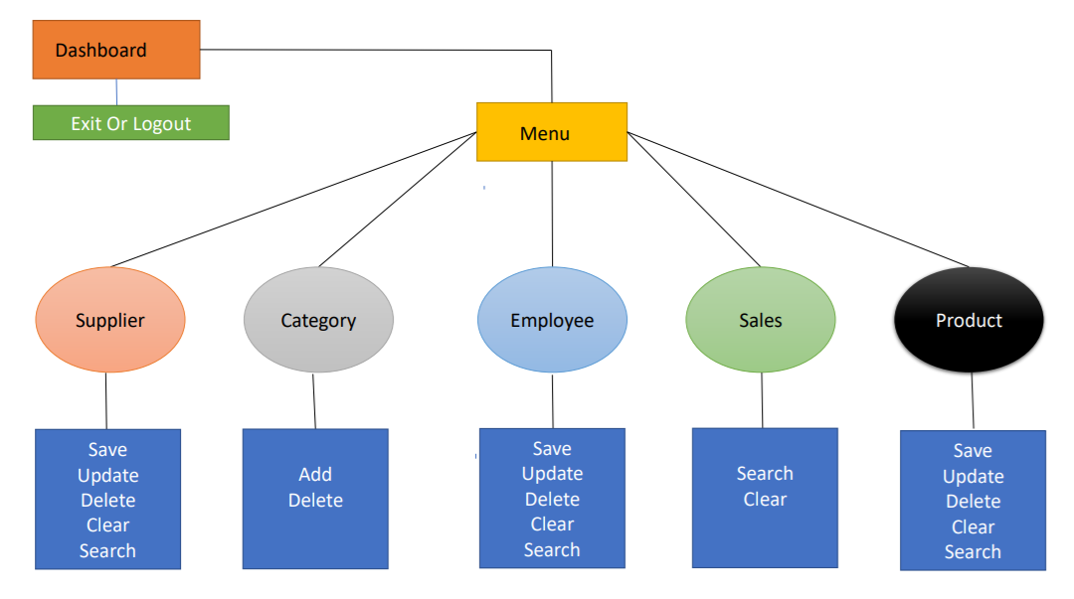

Slide 8
TABLE USED
EMPLOYEE TABLE
SUPPLIER TABLE
eid | name | E-mail | gender | contact | dob | doj | password | Usertype | address | salary
invoice | Name | Contact | description

Slide 9
CATEGORY TABLE
PRODUCT TABLE
cid | name
pid | Category | supplier | name | price | qty | status

Slide 10
FUTURE SCOPE
We can give more advance software for Inventory Management System including more facilities.
We will host the platform on online servers to make it accessible worldwide.
Integrate multiple load balancers to distribute the loads of the system.
Create the master and slave database structure to reduce the overload of the database queries.
Implement the backup mechanism for taking backup of codebase and data baseon regular basis on different servers

Slide 11


